Slide 1

Bank Customer Churn Analysis using Python
Prepared by: Enos Mohod Domain: Python for Data Analytics
© All rights reserved by Fireblaze Technologies Pvt. Ltd.

Slide 2
Problem Statement
Customer churn is a critical challenge for banks, as losing existing customers directly impacts revenue and long-term growth. Understanding why customers leave the bank is essential for designing effective retention strategies.
The bank wants to analyze customer data to:
Identify churn patterns among customers
Understand the key factors influencing churn
Compare churn behavior across different customer segments
This analysis aims to provide data-driven insights that can help the bank reduce customer churn and improve customer retention.
© All rights reserved by Fireblaze Technologies Pvt. Ltd.

Slide 3
About the Data
The dataset contains customer-level information from a retail bank and is used to analyze customer churn behavior.
Key details of the dataset:
Total records: 10,000 customers
Each row represents one unique customer
Target variable: Exited
0 → Customer retained
1 → Customer churned
Key features used in analysis:
Demographic details: Gender, Age, Geography
Account details: Balance, Number of Products
Customer behavior: Active Member status
Churn indicator: Exited
This dataset enables analysis of how customer demographics and behavior impact churn.
© All rights reserved by Fireblaze Technologies Pvt. Ltd.

Slide 4
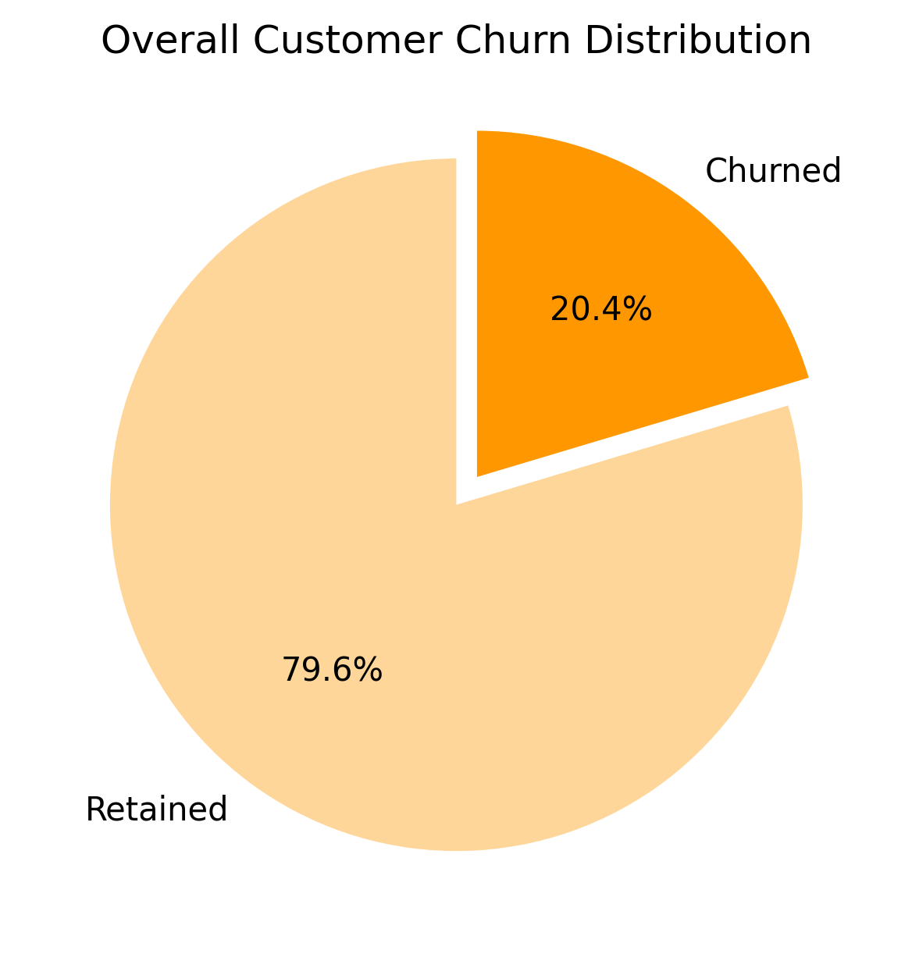
Proposed Solution
Insight 1: Overall Customer Churn
Key Findings
Out of 10,000 customers, 2,037 customers (20.37%) have exited the bank.
7,963 customers (79.63%) are currently retained.
Business Interpretation
Approximately 1 out of every 5 customers has churned.
Although the majority of customers are retained, a 20% churn rate is significant for a banking business.
This highlights the need to analyze churn drivers across customer segments to reduce future attrition.
Visualization
© All rights reserved by Fireblaze Technologies Pvt. Ltd.

Slide 5
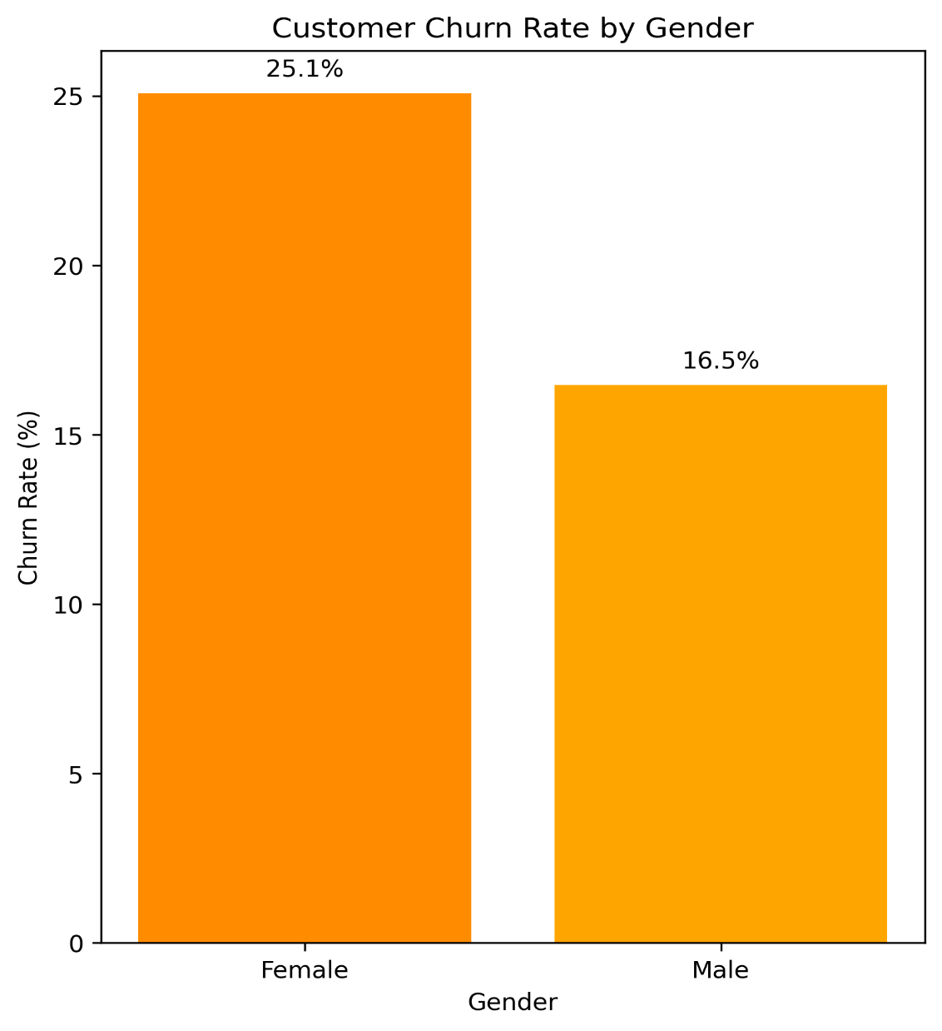
Proposed Solution
Insight 2: Customer Churn by Gender
Key Findings
Female customers show a churn rate of ~25.07%.
Male customers show a lower churn rate of ~16.46%.
Female customers are significantly more likely to churn compared to male customers.
Business Interpretation
The higher churn rate among female customers indicates a potential gap in customer experience or product alignment for this segment.
This suggests that current banking services or engagement strategies may not be equally effective across genders.
Addressing gender-specific needs can help the bank reduce churn and improve long-term customer retention.
© All rights reserved by Fireblaze Technologies Pvt. Ltd.

Slide 6
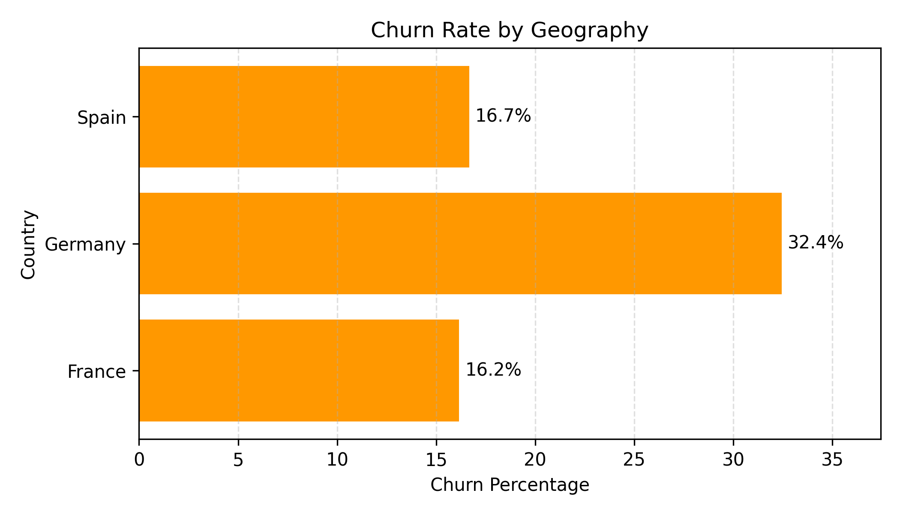
Proposed Solution
Insight 3: Customer Churn by Geography
Key Findings
Germany has the highest churn rate at ~32.44%.
France shows a churn rate of ~16.15%.
Spain has a similar churn rate of ~16.67%.
Customers in Germany are churning at nearly double the rate compared to France and Spain.
Business Interpretation
Germany shows a significantly higher churn rate, indicating region-specific retention issues.
France and Spain have relatively stable churn levels, suggesting better customer retention.
The bank should prioritize Germany for targeted churn-reduction strategies.
© All rights reserved by Fireblaze Technologies Pvt. Ltd.

Slide 7
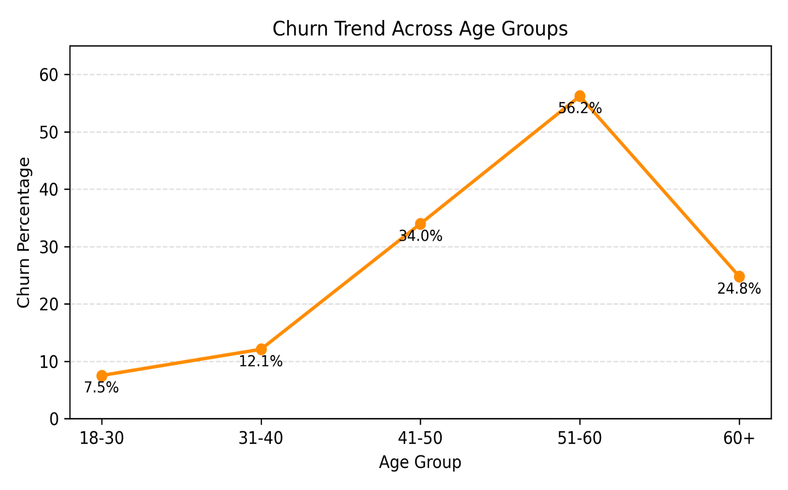
Proposed Solution
Insight 4: Churn Rate by Age Group
Key Findings
Customers aged 18–30 show the lowest churn rate (~7.5%).
Churn increases significantly for 41–50 (≈34%) and peaks at 51–60 (≈56%).
Customers 60+ also show relatively high churn (~25%).
Business Interpretation
Churn risk increases with customer age, especially after 40.
Middle-aged and senior customers may require targeted retention strategies, such as personalized services or relationship management.
© All rights reserved by Fireblaze Technologies Pvt. Ltd.

Slide 8
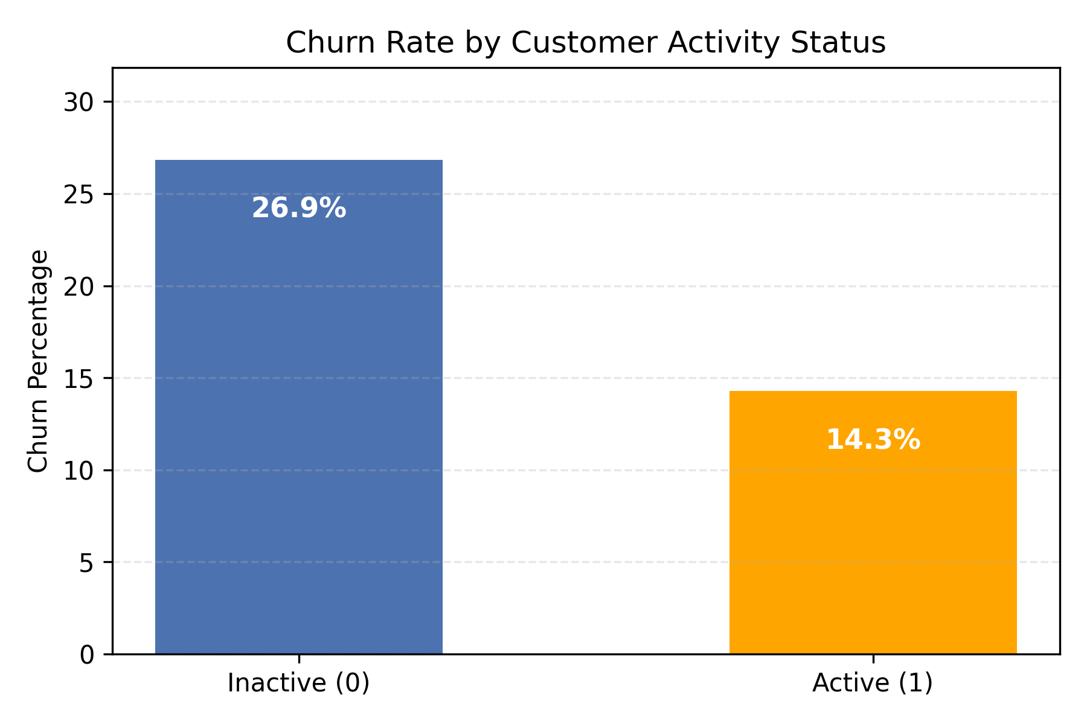
Proposed Solution
Insight 5: Churn by Active Membership
Key Findings
Customers who are not active members show a significantly higher churn rate (~26.9%).
Active customers have a lower churn rate (~14.3%).
Inactive customers are almost 2× more likely to churn compared to active ones.
Business Interpretation
Customer engagement directly impacts retention.
Improving activity levels (usage, interactions, transactions) can substantially reduce churn.
The bank should proactively target inactive customers with engagement and retention initiatives.
© All rights reserved by Fireblaze Technologies Pvt. Ltd.

Slide 9
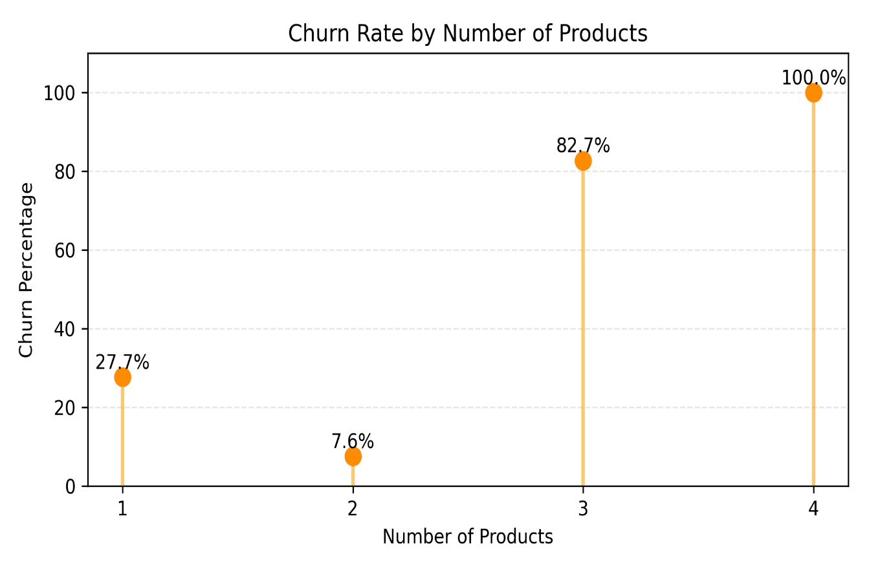
Proposed Solution
Insight 6: Churn Rate by Number of Products
Key Findings
Customers with 2 products show the lowest churn (~7.6%).
Customers with 1 product have a moderate churn (~27.7%).
Customers with 3 or 4 products show extremely high churn (82%–100%), indicating a data imbalance rather than a stable behavioral pattern.
Business Interpretation
Customers holding exactly two products appear most stable.
Extremely high churn for 3–4 products likely reflects very few customers, so this segment should be interpreted cautiously.
The bank should focus on cross-selling from 1 → 2 products, which aligns with lower churn.
© All rights reserved by Fireblaze Technologies Pvt. Ltd.

Slide 10
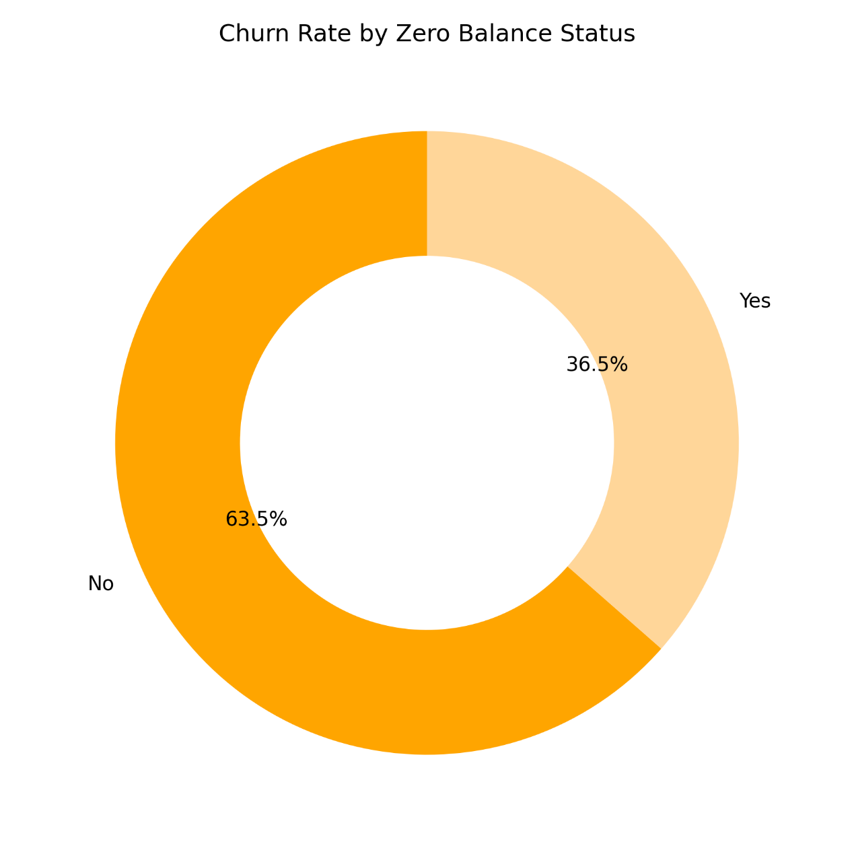
Proposed Solution
Insight 7 – Zero Balance vs Churn
Key Findings
Customers with non-zero balance have a churn rate of ~24%.
Customers with zero balance show a lower churn rate of ~14%.
Business Interpretation
Customers maintaining balances are more likely to churn, possibly due to better access to competing banking options.
Balance size alone does not guarantee customer retention.
.
© All rights reserved by Fireblaze Technologies Pvt. Ltd.

Slide 11
Conclusion
Key Takeaways
The bank has an overall churn rate of ~20%, indicating a significant retention challenge.
Churn is not uniform across customers and varies by:
Gender
Geography
Age group
Activity status
Product usage
Account balance
Inactive customers, older age groups, and customers in Germany show the highest churn risk.
Customers with moderate product adoption (2 products) are the most stable.
Business Impact
Churn can be reduced by focusing on high-risk customer segments.
Data-driven insights can help the bank design targeted retention strategies instead of generic campaigns.
Improving customer engagement and personalization can directly improve retention and profitability.
© All rights reserved by Fireblaze Technologies Pvt. Ltd.

Slide 12
Future Scope
Future Scope: Predictive Churn Analysis (Machine Learning)
How this project can be extended
The same dataset can be used to build a predictive churn model.
The target variable (Exited) makes this a binary classification problem.
Proposed ML Approach
Use customer attributes such as:
Age, Gender, Geography
Balance, Number of Products
Active Membership status
Apply machine learning models like:
Logistic Regression
Decision Tree
Random Forest
Business Value of Predictive Model
Identify customers likely to churn in advance.
Enable proactive retention strategies.
Reduce customer acquisition costs and improve customer lifetime value.
© All rights reserved by Fireblaze Technologies Pvt. Ltd.

Slide 13
THANK YOU

